Slide 1

Ergonomics Semester 2 Week 11

Slide 2
What had been discussed last week
Design an algorithm to handle stress, cumulative damage, and risk
Look for the shoulder information from 3dsspp research paper

Slide 3
Timeline
Content | Date | Progress
Learning Basics of Deep Learning | Sep 2022 | Done
Installing Alphapose/Openpose/VideoPose3D | Sep-Oct 2022 | Done
Learning Ergonomics Basics | Oct-Nov 2022 | Done
Forming a Framework of Time Continuous Cumulative Fatigue
Preparing for Final Exam | Nov-Dec 2022 | Done
Review the Time Continuous Cumulative Fatigue Framework | Dec 2022 | Done
Trying to Extract Coordinates Using Alphapose/Openpose | Dec 2022
Adding on a Cumulative Fatigue Assessment using Alphapose/Openpose with Python | Jan-Mar 2023
Writing a Technical Report for our Research | Mar 2023

Slide 4
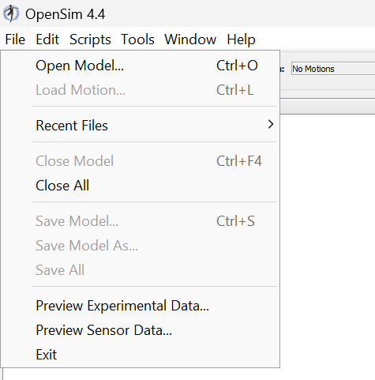
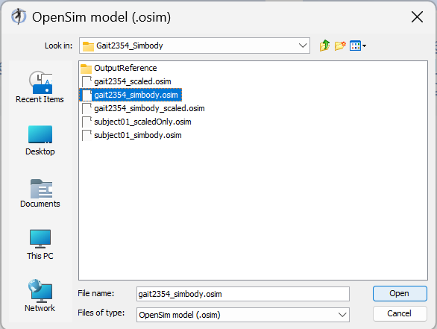
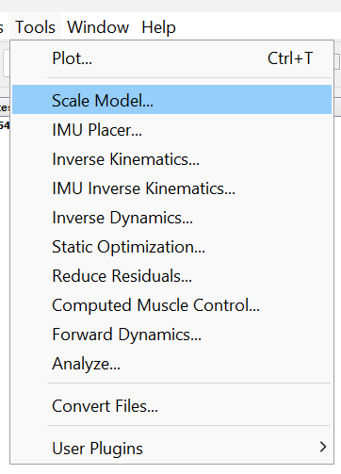
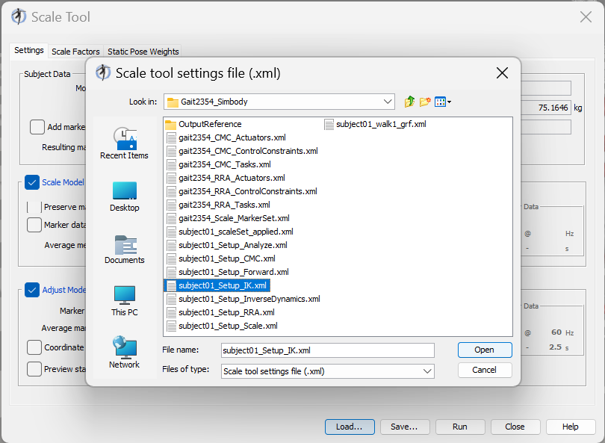
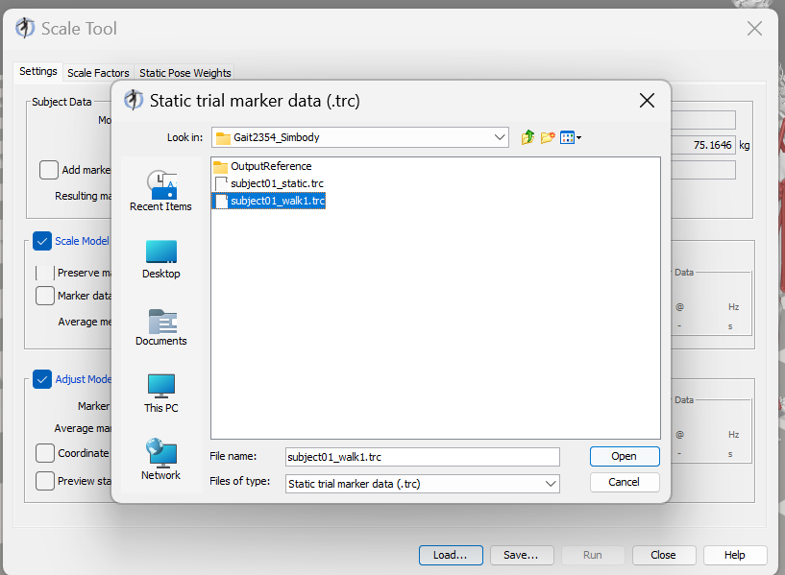
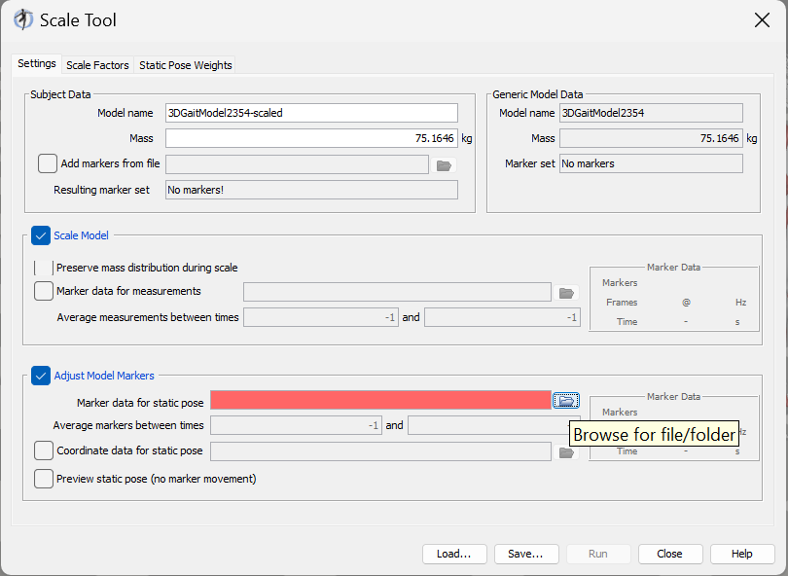
Learning How to Use OpenSim

Slide 5
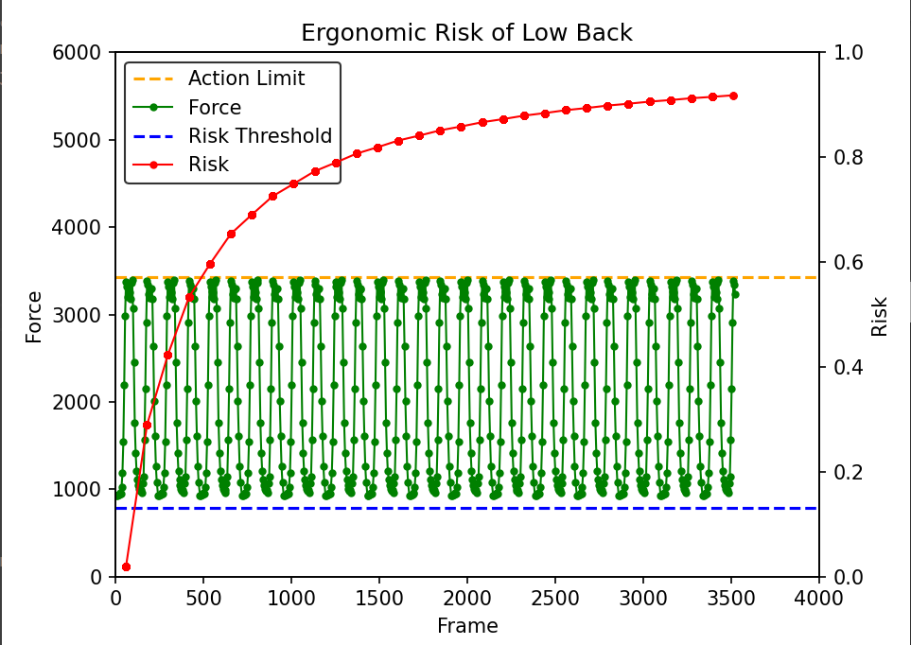
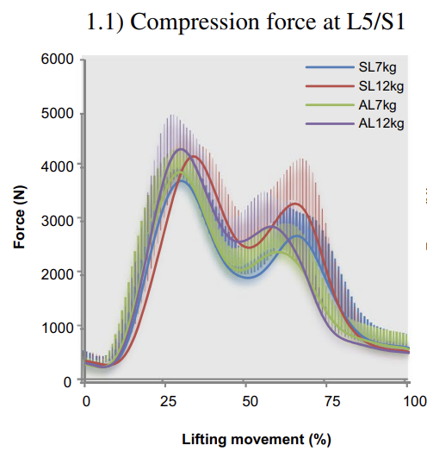
Our Method VS OpenSim
a = 10
Body weight = 600N
Repetition = 30
Load = 70N
Body weight = 600N
Repetition = 1
Load = 70N

Slide 6
Challenges of This Week
Learning OpenSim

Slide 7
Next Meeting
Conclude our current results
Plan for the next step (research paper, conference, etc)

